Slide 1
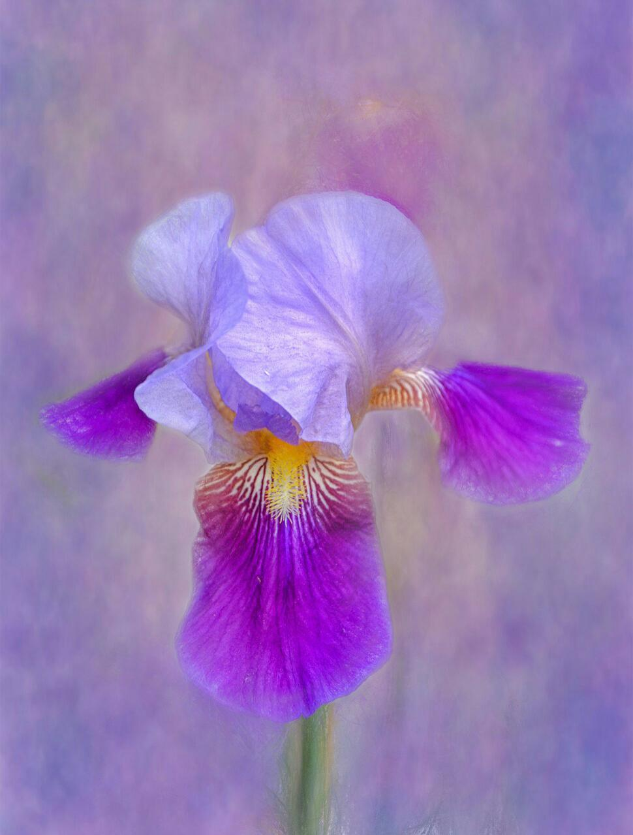

TUGAS BESAR DATA MINNING
https://github.com/nurulkhotimah-if19/Tugas-Besar-Data-Minning
Dataset Bunga Iris dan Github Project

Slide 2



Data Mahasiswa
Nurul Khotimah
3311911089
https://github.com/nurulkhotimah-if19
Alviana Hardiana
3311911093
https://github.com/alviihardiana

Slide 3

Apa itu Github?
Github adalah layanan cloud untuk menyimpan dan mengelola project/ repo git
Github merupakan instagramnya para programmer.
Kenapa?
Karena Github tersedia secara online dan dapat digunakan untuk mengupload project, repo, serta source code yang bisa dilihat, dilike, bahkan dimodifikasi oleh orang lain.

Slide 4

Dataset: https://archive.ics.uci.edu/ml/datasets/iris
sepal length in cm | sepal width in cm | petal length in cm | petal width in cm | class
5.1 | 3.5 | 1.4 | 0.2 | Iris-setosa
4.9 | 3 | 1.4 | 0.2 | Iris-setosa
4.7 | 3.2 | 1.3 | 0.2 | Iris-setosa
4.6 | 3.1 | 1.5 | 0.2 | Iris-setosa
5 | 3.6 | 1.4 | 0.2 | Iris-setosa
5.4 | 3.9 | 1.7 | 0.4 | Iris-setosa
4.6 | 3.4 | 1.4 | 0.3 | Iris-setosa
5 | 3.4 | 1.5 | 0.2 | Iris-setosa
4.4 | 2.9 | 1.4 | 0.2 | Iris-setosa
4.9 | 3.1 | 1.5 | 0.1 | Iris-setosa
5.4 | 3.7 | 1.5 | 0.2 | Iris-setosa
4.8 | 3.4 | 1.6 | 0.2 | Iris-setosa
4.8 | 3 | 1.4 | 0.1 | Iris-setosa
4.3 | 3 | 1.1 | 0.1 | Iris-setosa
5.8 | 4 | 1.2 | 0.2 | Iris-setosa
5.7 | 4.4 | 1.5 | 0.4 | Iris-setosa
5.4 | 3.9 | 1.3 | 0.4 | Iris-setosa
5.1 | 3.5 | 1.4 | 0.3 | Iris-setosa
5.7 | 3.8 | 1.7 | 0.3 | Iris-setosa
5.1 | 3.8 | 1.5 | 0.3 | Iris-setosa
5.4 | 3.4 | 1.7 | 0.2 | Iris-setosa
5.1 | 3.7 | 1.5 | 0.4 | Iris-setosa
4.6 | 3.6 | 1 | 0.2 | Iris-setosa
5.1 | 3.3 | 1.7 | 0.5 | Iris-setosa
4.8 | 3.4 | 1.9 | 0.2 | Iris-setosa
5 | 3 | 1.6 | 0.2 | Iris-setosa
5 | 3.4 | 1.6 | 0.4 | Iris-setosa
5.2 | 3.5 | 1.5 | 0.2 | Iris-setosa
5.2 | 3.4 | 1.4 | 0.2 | Iris-setosa
4.7 | 3.2 | 1.6 | 0.2 | Iris-setosa
4.8 | 3.1 | 1.6 | 0.2 | Iris-setosa
5.4 | 3.4 | 1.5 | 0.4 | Iris-setosa
5.2 | 4.1 | 1.5 | 0.1 | Iris-setosa
5.5 | 4.2 | 1.4 | 0.2 | Iris-setosa
4.9 | 3.1 | 1.5 | 0.1 | Iris-setosa
5 | 3.2 | 1.2 | 0.2 | Iris-setosa
5.5 | 3.5 | 1.3 | 0.2 | Iris-setosa
4.9 | 3.1 | 1.5 | 0.1 | Iris-setosa
4.4 | 3 | 1.3 | 0.2 | Iris-setosa
5.1 | 3.4 | 1.5 | 0.2 | Iris-setosa
5 | 3.5 | 1.3 | 0.3 | Iris-setosa
4.5 | 2.3 | 1.3 | 0.3 | Iris-setosa
4.4 | 3.2 | 1.3 | 0.2 | Iris-setosa
5 | 3.5 | 1.6 | 0.6 | Iris-setosa
5.1 | 3.8 | 1.9 | 0.4 | Iris-setosa
4.8 | 3 | 1.4 | 0.3 | Iris-setosa
5.1 | 3.8 | 1.6 | 0.2 | Iris-setosa
4.6 | 3.2 | 1.4 | 0.2 | Iris-setosa
5.3 | 3.7 | 1.5 | 0.2 | Iris-setosa
5 | 3.3 | 1.4 | 0.2 | Iris-setosa
7 | 3.2 | 4.7 | 1.4 | Iris-versicolor
6.4 | 3.2 | 4.5 | 1.5 | Iris-versicolor
6.9 | 3.1 | 4.9 | 1.5 | Iris-versicolor
5.5 | 2.3 | 4 | 1.3 | Iris-versicolor
6.5 | 2.8 | 4.6 | 1.5 | Iris-versicolor
5.7 | 2.8 | 4.5 | 1.3 | Iris-versicolor
6.3 | 3.3 | 4.7 | 1.6 | Iris-versicolor
4.9 | 2.4 | 3.3 | 1 | Iris-versicolor
6.6 | 2.9 | 4.6 | 1.3 | Iris-versicolor
5.2 | 2.7 | 3.9 | 1.4 | Iris-versicolor
5 | 2 | 3.5 | 1 | Iris-versicolor
5.9 | 3 | 4.2 | 1.5 | Iris-versicolor
6 | 2.2 | 4 | 1 | Iris-versicolor
6.1 | 2.9 | 4.7 | 1.4 | Iris-versicolor
5.6 | 2.9 | 3.6 | 1.3 | Iris-versicolor
6.7 | 3.1 | 4.4 | 1.4 | Iris-versicolor
5.6 | 3 | 4.5 | 1.5 | Iris-versicolor
5.8 | 2.7 | 4.1 | 1 | Iris-versicolor
6.2 | 2.2 | 4.5 | 1.5 | Iris-versicolor
5.6 | 2.5 | 3.9 | 1.1 | Iris-versicolor
5.9 | 3.2 | 4.8 | 1.8 | Iris-versicolor
6.1 | 2.8 | 4 | 1.3 | Iris-versicolor
6.3 | 2.5 | 4.9 | 1.5 | Iris-versicolor
6.1 | 2.8 | 4.7 | 1.2 | Iris-versicolor
6.4 | 2.9 | 4.3 | 1.3 | Iris-versicolor
6.6 | 3 | 4.4 | 1.4 | Iris-versicolor
6.8 | 2.8 | 4.8 | 1.4 | Iris-versicolor
6.7 | 3 | 5 | 1.7 | Iris-versicolor
6 | 2.9 | 4.5 | 1.5 | Iris-versicolor
5.7 | 2.6 | 3.5 | 1 | Iris-versicolor
5.5 | 2.4 | 3.8 | 1.1 | Iris-versicolor
5.5 | 2.4 | 3.7 | 1 | Iris-versicolor
5.8 | 2.7 | 3.9 | 1.2 | Iris-versicolor
6 | 2.7 | 5.1 | 1.6 | Iris-versicolor
5.4 | 3 | 4.5 | 1.5 | Iris-versicolor
6 | 3.4 | 4.5 | 1.6 | Iris-versicolor
6.7 | 3.1 | 4.7 | 1.5 | Iris-versicolor
6.3 | 2.3 | 4.4 | 1.3 | Iris-versicolor
5.6 | 3 | 4.1 | 1.3 | Iris-versicolor
5.5 | 2.5 | 4 | 1.3 | Iris-versicolor
5.5 | 2.6 | 4.4 | 1.2 | Iris-versicolor
6.1 | 3 | 4.6 | 1.4 | Iris-versicolor
5.8 | 2.6 | 4 | 1.2 | Iris-versicolor
5 | 2.3 | 3.3 | 1 | Iris-versicolor
5.6 | 2.7 | 4.2 | 1.3 | Iris-versicolor
5.7 | 3 | 4.2 | 1.2 | Iris-versicolor
5.7 | 2.9 | 4.2 | 1.3 | Iris-versicolor
6.2 | 2.9 | 4.3 | 1.3 | Iris-versicolor
5.1 | 2.5 | 3 | 1.1 | Iris-versicolor
5.7 | 2.8 | 4.1 | 1.3 | Iris-versicolor
6.3 | 3.3 | 6 | 2.5 | Iris-virginica
5.8 | 2.7 | 5.1 | 1.9 | Iris-virginica
7.1 | 3 | 5.9 | 2.1 | Iris-virginica
6.3 | 2.9 | 5.6 | 1.8 | Iris-virginica
6.5 | 3 | 5.8 | 2.2 | Iris-virginica
7.6 | 3 | 6.6 | 2.1 | Iris-virginica
4.9 | 2.5 | 4.5 | 1.7 | Iris-virginica
7.3 | 2.9 | 6.3 | 1.8 | Iris-virginica
6.7 | 2.5 | 5.8 | 1.8 | Iris-virginica
7.2 | 3.6 | 6.1 | 2.5 | Iris-virginica
6.5 | 3.2 | 5.1 | 2 | Iris-virginica
6.4 | 2.7 | 5.3 | 1.9 | Iris-virginica
6.8 | 3 | 5.5 | 2.1 | Iris-virginica
5.7 | 2.5 | 5 | 2 | Iris-virginica
5.8 | 2.8 | 5.1 | 2.4 | Iris-virginica
6.4 | 3.2 | 5.3 | 2.3 | Iris-virginica
6.5 | 3 | 5.5 | 1.8 | Iris-virginica
7.7 | 3.8 | 6.7 | 2.2 | Iris-virginica
7.7 | 2.6 | 6.9 | 2.3 | Iris-virginica
6 | 2.2 | 5 | 1.5 | Iris-virginica
6.9 | 3.2 | 5.7 | 2.3 | Iris-virginica
5.6 | 2.8 | 4.9 | 2 | Iris-virginica
7.7 | 2.8 | 6.7 | 2 | Iris-virginica
6.3 | 2.7 | 4.9 | 1.8 | Iris-virginica
6.7 | 3.3 | 5.7 | 2.1 | Iris-virginica
7.2 | 3.2 | 6 | 1.8 | Iris-virginica
6.2 | 2.8 | 4.8 | 1.8 | Iris-virginica
6.1 | 3 | 4.9 | 1.8 | Iris-virginica
6.4 | 2.8 | 5.6 | 2.1 | Iris-virginica
7.2 | 3 | 5.8 | 1.6 | Iris-virginica
7.4 | 2.8 | 6.1 | 1.9 | Iris-virginica
7.9 | 3.8 | 6.4 | 2 | Iris-virginica
6.4 | 2.8 | 5.6 | 2.2 | Iris-virginica
6.3 | 2.8 | 5.1 | 1.5 | Iris-virginica
6.1 | 2.6 | 5.6 | 1.4 | Iris-virginica
7.7 | 3 | 6.1 | 2.3 | Iris-virginica
6.3 | 3.4 | 5.6 | 2.4 | Iris-virginica
6.4 | 3.1 | 5.5 | 1.8 | Iris-virginica
6 | 3 | 4.8 | 1.8 | Iris-virginica
6.9 | 3.1 | 5.4 | 2.1 | Iris-virginica
6.7 | 3.1 | 5.6 | 2.4 | Iris-virginica
6.9 | 3.1 | 5.1 | 2.3 | Iris-virginica
5.8 | 2.7 | 5.1 | 1.9 | Iris-virginica
6.8 | 3.2 | 5.9 | 2.3 | Iris-virginica
6.7 | 3.3 | 5.7 | 2.5 | Iris-virginica
6.7 | 3 | 5.2 | 2.3 | Iris-virginica
6.3 | 2.5 | 5 | 1.9 | Iris-virginica
6.5 | 3 | 5.2 | 2 | Iris-virginica
6.2 | 3.4 | 5.4 | 2.3 | Iris-virginica
5.9 | 3 | 5.1 | 1.8 | Iris-virginica

Slide 5

Penjelasan dan Analisa Dataset
Kelas Dataset:
Iris –Setosa
Iris –Versicolour
Iris -Virginica
Atribut Dataset:
Panjang putik dalam cm
Lebar putik dalam cm
Panjang kelopak dalam cm
Lebar kelopak dalam cm

Slide 6

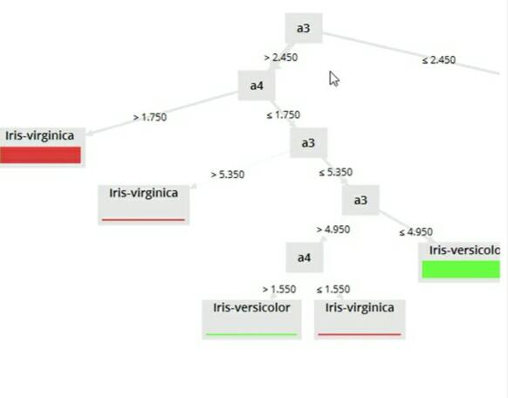
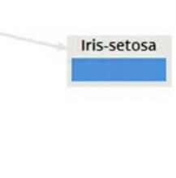
Proses Data Minning
Decision Tree (Pohon Keputusan)

Slide 7

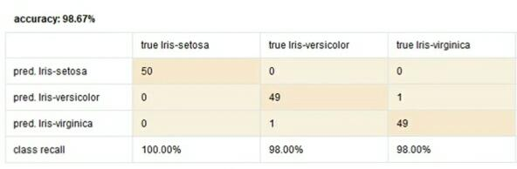
Hasil Analisa Data Minning

Slide 8
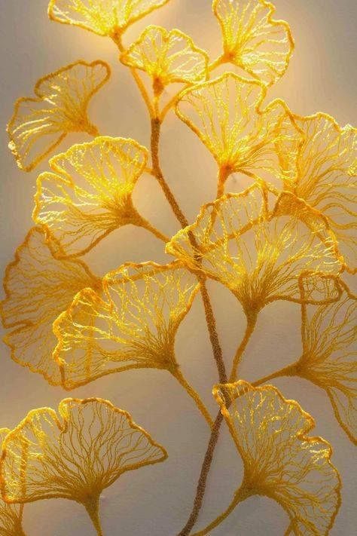
Hasil Data Minning
Id | SepalLengthCm | SepalWidthCm | PetalLengthCm | PetalWidthCm | Class
0 | 5.1 | 3.5 | 1.4 | 0.2 | Iris -Setosa
1 | 4.9 | 3,0 | 1.4 | 0.2 | Iris -Setosa
2 | 4.7 | 3.2 | 1.3 | 0.2 | Iris -Setosa
3 | 4.6 | 3.1 | 1.5 | 0.2 | Iris -Setosa
4 | 5,0 | 3.6 | 1.4 | 0.2 | Iris -Setosa
5 | 5.4 | 3.9 | 1.7 | 0.4 | Iris -Setosa
6 | 4.6 | 3.4 | 1.4 | 0.3 | Iris -Setosa
7 | 5,0 | 3.4 | 1.5 | 0.2 | Iris -Setosa
8 | 4.4 | 2.9 | 1.4 | 0.2 | Iris -Setosa
9 | 4.9 | 3.1 | 1.5 | 0.1 | Iris -Setosa

Slide 9

References:
https://youtu.be/I4mQ-gVoj4w
https://archive.ics.uci.edu/ml/datasets.php
https://learning-if.polibatam.ac.id/mod/resource/view.php?id=5810

Slide 10

Thankyou!!!

